Slide 1
Arrays
CS 201, Summer 2013

Slide 2
ADDITIONAL READING
Arrays
  Chapter 5 of Pearson textbook
  http://www.learncpp.com/cpp-tutorial/61-arrays-part-i/

Slide 3
What are arrays?
In C++, arrays are the simplest data-type for storing a series (list, array) of values.
Arrays are similar to Python's lists, except that:
  All elements stored in the list must be of the same data-type
  There are no functions for our arrays – for example, we must keep track of the array's size manually
  An array cannot be resized; you set a specific size during its declaration and it cannot change.

Slide 4
What are arrays?
Arrays can store any data-type that you would use for a variable:
  int
  float
  string
  bool
  Custom object

Slide 5
What are arrays?
Each element in an array has its own index, which is the position in the array.
Index starts at 0.
If an array is of size 10, then the indices of the elements are from 0 to 9.

Slide 6
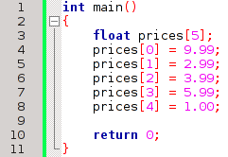
Array declaration
There are several ways to declare an array.
An array will always have square brackets [ ] after the variable name to signify that it's an array.
Declaring an array
Storing data in the array manually

Slide 7

Array declaration
We can declare an array without a size within the square brackets [ ] but ONLY if we immediately give it a list of data.
The array will automatically be given the size matching the amount of initial elements you specified.
This array will have 5 elements.

Slide 8
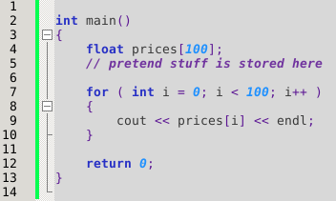
For Loops
Once we're dealing with Arrays, for loops become very handy.
Since we can access a certain element of the array with the subscript operator [ ], we can use a for-loop to access all the elements of an array.
  For example, to display all values in the array, or to loop through to get user input for each element.

Slide 9
Why no resize?
When we get into memory management, we will learn how to make dynamic arrays.
The reason the C++ array does not have the ability to resize deals with memory.

Slide 10
Why no resize?
When an array is declared, as with any variable, memory is set aside for this item.
The amount of memory taken up is dependent on the data-type
  int and float take 4 bytes, bool takes 1 byte*
An array allocates enough memory for n amount of that data-type (n being the size of the array).
* Data-type information from http://www.cplusplus.com/doc/tutorial/variables/

Slide 11
Y U NO RESIZE?
The elements in the array are also stored sequentially in memory – one after another.
Let's say we create an array of size 5, and it takes up 5 memory “blocks”.
But then we create another variable, which takes up the memory “block” after our array.
Elements in an array must be sequential, but we cannot add to the array because that memory is taken up by something else.
0
1
2
3
4
0
1
2
3
4
0
1
2
3
4
5
6
NOPE

Slide 12
Y U NO RESIZE?
Well, why can't we store different elements in an array at different places in memory?
0
1
2
3
4
5
6
7
Arrays in C++ aren't “smart” enough to handle keeping track of its elements like this – it knows enough to “walk” through its elements, and how big each element is (because they're all the same data-type!)

Slide 13
Y U NO RESIZE?
Well, why can't we store different elements in an array at different places in memory?
0
1
2
3
4
5
6
7
BUT, we can write our own data-type that can keep track of its elements intelligently
  We will do this later in the semester with Classes, Pointers, Memory Management, and data-structures like Lists, Stacks, and Queues!

Slide 14
Why not Python?
Python is a higher-level language than C++.
  “higher-level” means “further from the hardware”; C++ is “closer to the hardware”.
  Not a measure of “easiness” - Usually a lower-level language may be harder or require more programming.
Higher-level languages have much more pre-written code available to you, and hide the complexity.
C++ is quite a bit lower-level, and requires manual memory management.
  Memory Management is a big part of C++.
  With Java and C#, Memory Management tends to be more hidden from you.

Slide 15
Arrays as arguments
An array has the potential to be A LOT BIGGER than any single variable, since it can essentially be the size of a few variables, or a few hundred!
When arguments are passed to a function, the variable's information is copied to a new memory address and given to the function.
The function does not mess with the original variable's data; it only has a copy.
  This is called “pass by value”.

Slide 16
Arrays as arguments
Because an Array has the potential to be HUGE, C++ automatically does a favor for us – It passes Arrays by reference.
  By Value: A copy of the variable is made. This copy has a different memory address and will not change the original variable.
  By Reference: The address of the variable (/array) is given to the function. If the by-reference argument is changed inside the function, it's changed at the caller's level, too.

Slide 17
Arrays as arguments
If an array were copied when it were passed to a function, this copy process could take a long time!
If we just pass the array's address to the function, it takes virtually no time to do so. A memory address is essentially just a single integer!

Slide 18
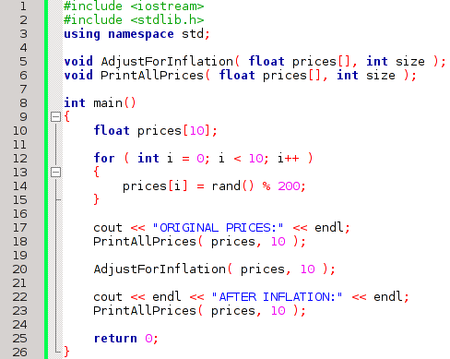
Arrays as arguments
Modifies the array
Prints all elements
Initializing elements of prices array.
prices array being passed by-reference

Slide 19
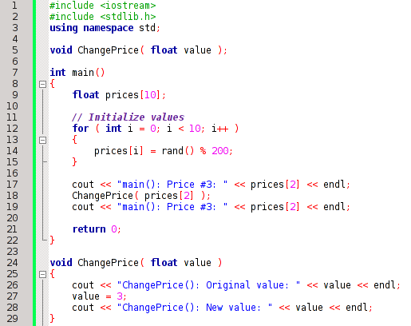
Arrays as arguments
However, we can pass one element of an array, and then it gets treated just like any other variable.
The function is only expecting a simple float
We can pass the function a specific element in an array.
The float is only passed by-value, and prices[2] will remain the same.

Slide 20
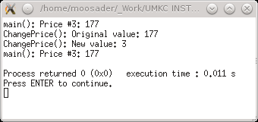
Arrays as arguments
However, we can pass one element of an array, and then it gets treated just like any other variable.
The price remains the same after the function call.

Slide 21
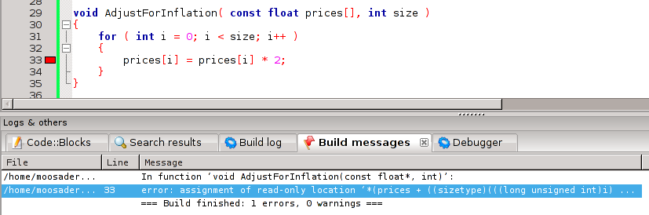
Don't change my data. :|
C++ automatically passes arrays by-reference, so any function receiving it can change its data.
What if we don't want this?
Make the array a const parameter!

Slide 22
Don't change my data. :|
If we make the array parameter const, then that function cannot change it.
If we try to make changes to it, we simply get a compile error.
  Fixing compile errors is a lot easier than finding out where the @!$^ your data is being corrupted!

